Slide 1
Chapter 2 Scientific Investigation

Slide 2
Topics Discussed
The Hallmarks of Scientific research
Some obstacles to conducting scientific
research in the management area
The Hypothetico-Deductive Method
Other types of Research

Slide 3
What is Meant by a Scientific Research?
Research is an organized, systematic, data-based, critical, objective, scientific inquiry into a specific problem that needs a solution
Scientific research focuses on solving problems and pursues a step-by-step logical, organized, and rigorous method to identify the problems, gather data, analyze them, and draw valid conclusions there from

Slide 4
What is Meant by a Scientific Research?
Thus, scientific research is not based on hunches, experience, and intuition (though these may play a part in final decision making), but a purposive and rigorous
Scientific research enables all those who are interested in researching about the same or similar issues to come up with comparable findings when the data are analyzed

Slide 5


Slide 6
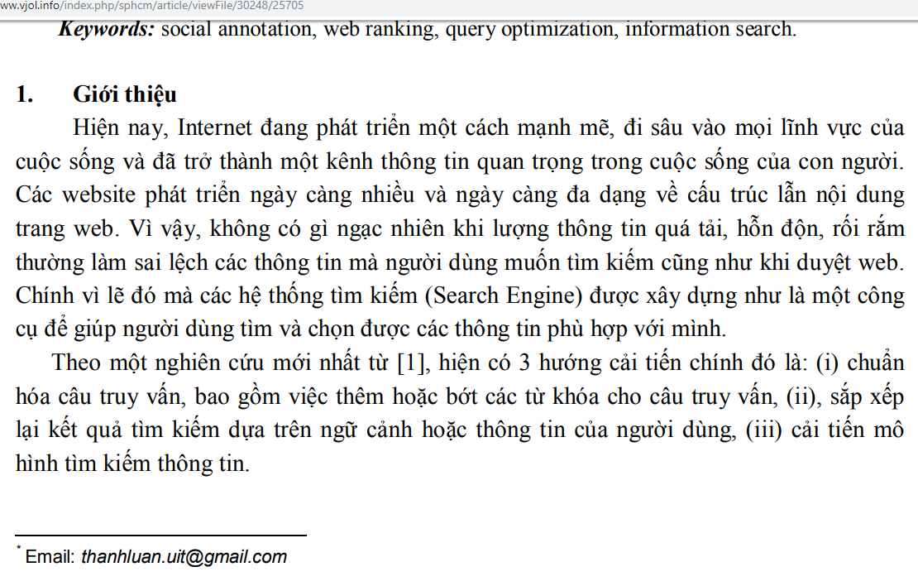

Slide 7
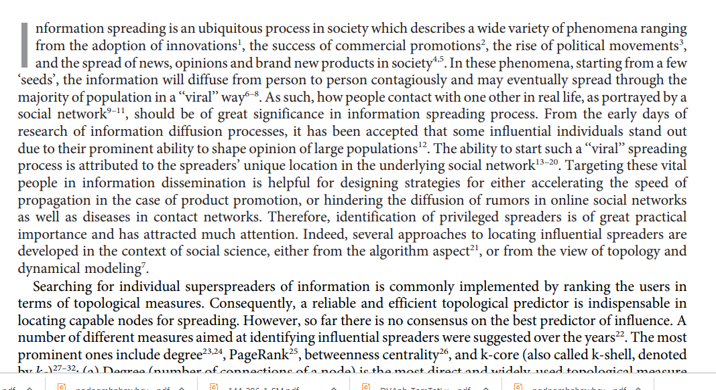

Slide 8
What is Meant by a Scientific Research?
Scientific research helps researchers to state their findings with accuracy and confidence.
This helps various other organizations to apply those solutions when they encounter similar problems.
Scientific investigation tends to be more objective than subjective, and helps managers to highlight the most critical factors at the workplace that need specific attention so as to avoid, minimize, or solve problems.

Slide 9
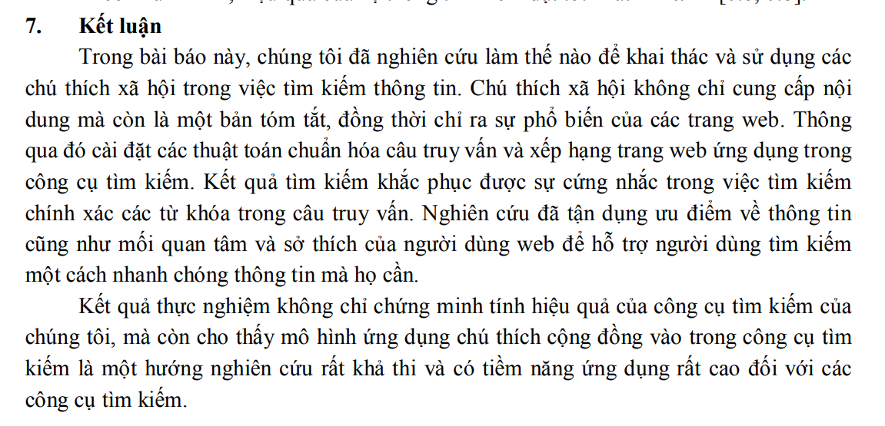

Slide 10
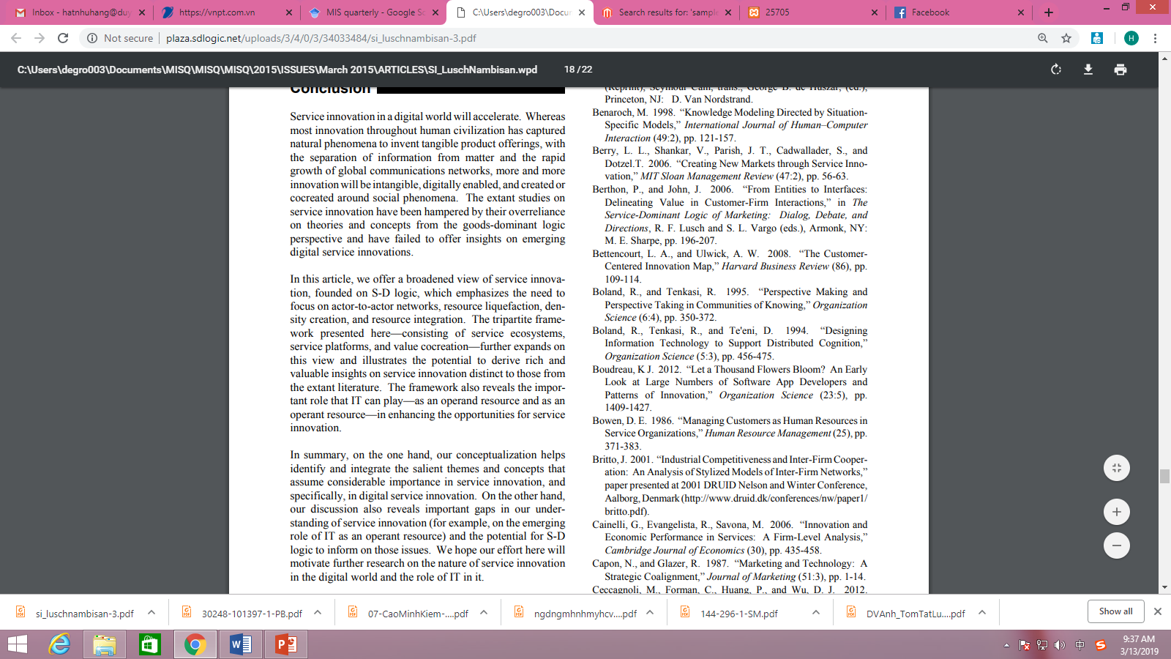

Slide 12
What is Meant by a Scientific Research?
Scientific research applies to both basic and applied research.
Applied research may or may not be generalizable to other organizations, depending on the extent to which differences exist in such factors as
Size
Nature of work
Characteristics of the employees
Structure of the organization

Slide 13
Topics Discussed
The Hallmarks of Scientific research
Some obstacles to conducting scientific
research in the management area
The Hypothetico-Deductive Method
Other types of Research

Slide 14
The Hallmarks of Scientific Research
1. Purposiveness
8. Parsimony
2. Rigor
7. Generalizability
Title
3. Testability
6. Objectivity
4. Replicability
5. Precision

Slide 15
The Hallmarks of Scientific Research
1. Purposiveness
8. Parsimony
2. Rigor
7. Generalizability
Title
3. Testability
6. Objectivity
4. Replicability
5. Precision

Slide 16
Web 2.0 – Service quality in tourism

Slide 17
1. Purposiveness
The researcher has started the research with a definite aim or purpose =>The research thus has a purposive focus.
Information technology(IT) and Service quality (SQ)
Web 2.0 technologies
(Factors)
Social network
Service quality
(Factors)
Intangible product
Tangible product
Tourism - Tripass
Arwin Co.
Company’s site
FB, Twiter…

Slide 18
The Hallmarks of Scientific Research
1. Purposiveness
8. Parsimony
2. Rigor
7. Generalizability
Title
3. Testability
6. Objectivity
4. Replicability
5. Precision

Slide 19
2. Rigor
A good theoretical base and a sound methodological design would add rigor to a purposive study.
Rigor connotes carefulness, scrupulousness, and the degree of exactitude in research investigations.

Slide 20
Example – theoretical background
Model of e-service quality (Santos, 2003)

Slide 21
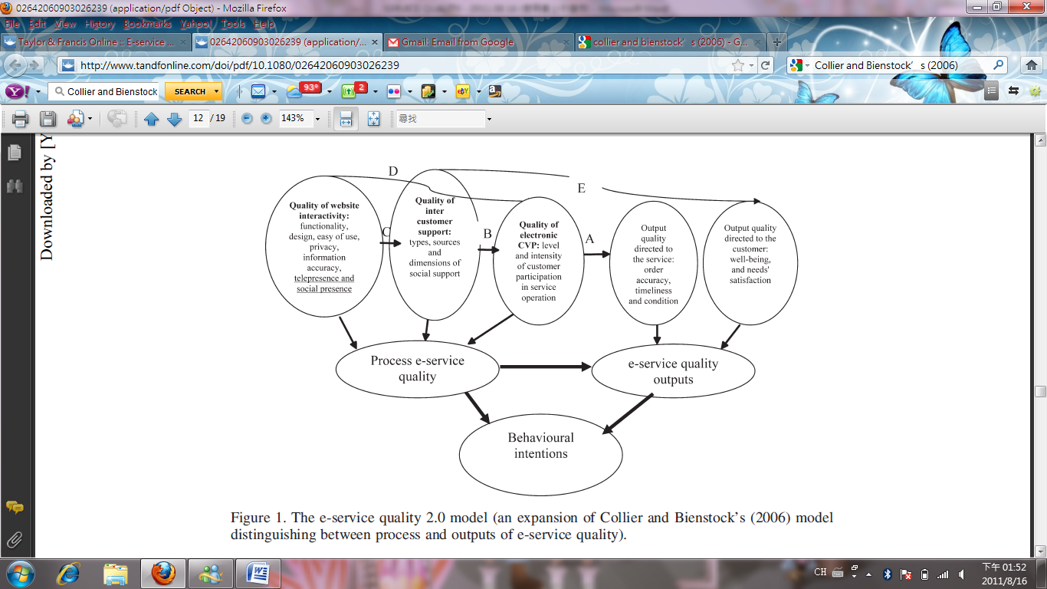
Example – theoretical background
Model of e-service quality (M. Sigala, 2009)

Slide 22
Quality of website interactivity
Research model
Process e-service quality
Quality of inter customer support
Quality of electronic CPV
Output quality directed to service
E-service quality outputs
Output quality directed to customer

Slide 23
Example of Design study
Qualitative methodology – Case study
Objects: Arwin and Tripass
Data collection: Interview, observation, secondary data
Who, when, where, what, how, why
Data analysis:
Coding
Quantitative methodology
Survey – questionnaires (sample, time)
Analysis software

Slide 24
The Hallmarks of Scientific Research
1. Purposiveness
8. Parsimony
2. Rigor
7. Generalizability
Title
3. Testability
6. Objectivity
4. Replicability
5. Precision

Slide 25
3. Testability
If researcher develops certain hypotheses, we can be tested by applying certain statistical tests to the data collected for the purpose.
To see whether or not the data support the educated conjectures or hypotheses that are developed after a careful study of the problem situation.

Slide 26
Quality of website interactivity
H1
H7
H10
Process e-service quality
Quality of inter customer support
H2
H8
H3
Quality of electronic CPV
H6
H11
H9
Output quality directed to service
H4
E-service quality outputs
Output quality directed to customer
H5

Slide 27
The Hallmarks of Scientific Research
1. Purposiveness
8. Parsimony
2. Rigor
7. Generalizability
3. Testability
6. Objectivity
4. Replicability
5. Precision

Slide 28
4. Replicability
To put it differently, the results of the tests of hypotheses should be supported again and yet again when the same type of research is repeated in other similar circumstances.
Our hypotheses would not have been supported merely by chance, but are reflective of the true state of affairs in the population.

Slide 29
Quality of website interactivity
H1
H7
H10
Process e-service quality
Quality of inter customer support
H2
H8
H3
Quality of electronic CPV
H6
H11
H9
Output quality directed to service
H4
E-service quality outputs
Output quality directed to customer
H5

Slide 30
Test hypotheses
1st time: using SPSS
H1~ H6: supported
H7, H8: unsupported
H9~H11: supported
2nd time: using LISREL
The same results

Slide 31
The Hallmarks of Scientific Research
1. Purposiveness
8. Parsimony
2. Rigor
7. Generalizability
3. Testability
6. Objectivity
4. Replicability
5. Precision

Slide 32

5. Precision and Confidence
We are unable to study the universe of items, events, or population we are interested in, and have to base our findings on a sample.
Precision refers to the closeness of the findings to reality based on a sample.
Confidence refers to the probability that our estimations are correct.

Slide 33
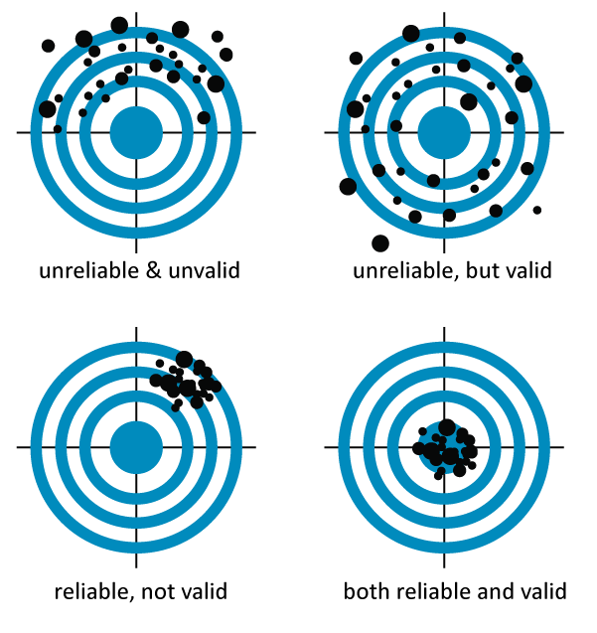
Độ ổn định (Reliability) và Độ chuẩn xác (Validity)

Slide 34
Quality of website interactivity
Estimate 2 factors have big impact – testing results are strong supported, and suitable with reality
H1
H7
H10
Process e-service quality
H2
Quality of inter customer support
H8
H3
Quality of electronic CPV
H6
H11
H9
Output quality directed to service
H4
E-service quality outputs
Output quality directed to customer
H5

Slide 35
The Hallmarks of Scientific Research
1. Purposiveness
8. Parsimony
2. Rigor
7. Generalizability
3. Testability
6. Objectivity
4. Replicability
5. Precision

Slide 36
6. Objectivity
The conclusions drawn through the interpretation of the results of data analysis should be objective.
They should be based on the facts of the findings derived from actual data, not on our own subjective or emotional values.
The more objective the interpretation of the data, the more scientific the research investigation becomes.

Slide 37
Findings after testing hypotheses
Hypotheses
H1~ H6: supported
H7, H8: unsupported (suppose all supported)
H9~H11: supported
Explanations for not supported hypotheses
Data – bias or not
Sample – suitable or not
Situational reasons – other factors
Suggestions

Slide 38
The Hallmarks of Scientific Research
1. Purposiveness
8. Parsimony
2. Rigor
7. Generalizability
3. Testability
6. Objectivity
4. Replicability
5. Precision

Slide 39
7. Generalizability
Generalizability refers to the scope of applicability of the research findings in one organizational setting to other settings.
The wider the range of applicability of the solutions generated by research, the more useful the research is to the users.
For wider generalizability, the research sampling design has to be logically developed and a number of other details in the data-collection methods need to be meticulously followed.

Slide 40
Conclusions
Academic implications
Managerial implications
From Theory to Practice
Generalizability
Information technology(IT) and Service quality (SQ)
Web 2.0 technologies
(Factors)
Social network
Service quality
(Factors)
Intangible product
Tangible product
Tourism - Tripass
Arwin Co.
Company’s site
FB, Twiter…

Slide 41
The Hallmarks of Scientific Research
1. Purposiveness
8. Parsimony
2. Rigor
7. Generalizability
3. Testability
6. Objectivity
4. Replicability
5. Precision

Slide 42
8. Parsimony
Simplicity in explaining the phenomena or problems that occur, and in generating solutions for the problems, is always preferred to complex research frameworks that consider an unmanageable number of factors.
The achievement of meaningful and parsimonious, rather than an elaborate and cumbersome, model for problem solution becomes a critical issue in research.

Slide 43
Functionality, design, ease of use, privacy, accuracy information, telepresence, social presence
Quality of website interactivity
Type, sources, dimensions of social support
Process e-service quality
Quality of inter customer support
Level and intensity of customer participation in service operation
Quality of electronic CPV
Order, accuracy, timeless, condition
Output quality directed to service
E-service quality outputs
Well-being, need’s satisfaction
Output quality directed to customer

Slide 44
Topics Discussed
The Hallmarks of Scientific research
Some obstacles to conducting scientific
research in the management area
The Hypothetico-Deductive Method
Other types of Research

Slide 45
Some obstacles to conducting scientific research in the management area
Measurement and collection data – feelings, emotions, attitudes and perceptions – human behavior
Sample – not representative, impossible for generalizability of findings – difficult to meet hallmarks

Slide 46
Topics Discussed
The Hallmarks of Scientific research
Some obstacles to conducting scientific
research in the management area
The Hypothetico-Deductive Method
Other types of Research

Slide 47
1. Deduction and Induction
Deductive reasoning: application of a general theory to a specific case (presumption，verify，then conclude)
Hypothesis testing
Inductive reasoning: a process where we observe specific phenomena and on this basis arrive at general conclusions (Observe phenomena, then conclude)
Counting white swans
Both inductive and deductive processes are often used in research

Slide 48
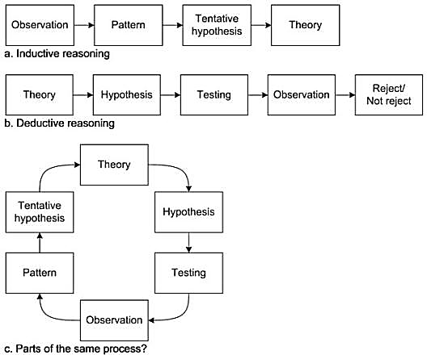
Deduction
Premises (reasons) give for the conclusion must agree with the real world (true).
The Conclusion must necessarily follow from the reason give (valid).
EX: All regular employees can be trusted not to steal. (Premise 1)
John is a regular employee. (Premise 2)
John can be trusted not to steal. (Conclusion)

Slide 49
Induction
The conclusion explains the facts, and the facts support the conclusion.
EX: I loaned my friend $50 last November and he failed to pay me back. (Premise)
I loaned him another $50 just before Christmas, which he hasn't paid back (Premise), and yet another $25 in January, which is still unpaid. (Premise)
I suppose it's time to face facts: He's never going to pay me back. (Conclusion)

Slide 50
Combining Induction and Deduction
Inductive reasoning
Deductive reasoning

Slide 51
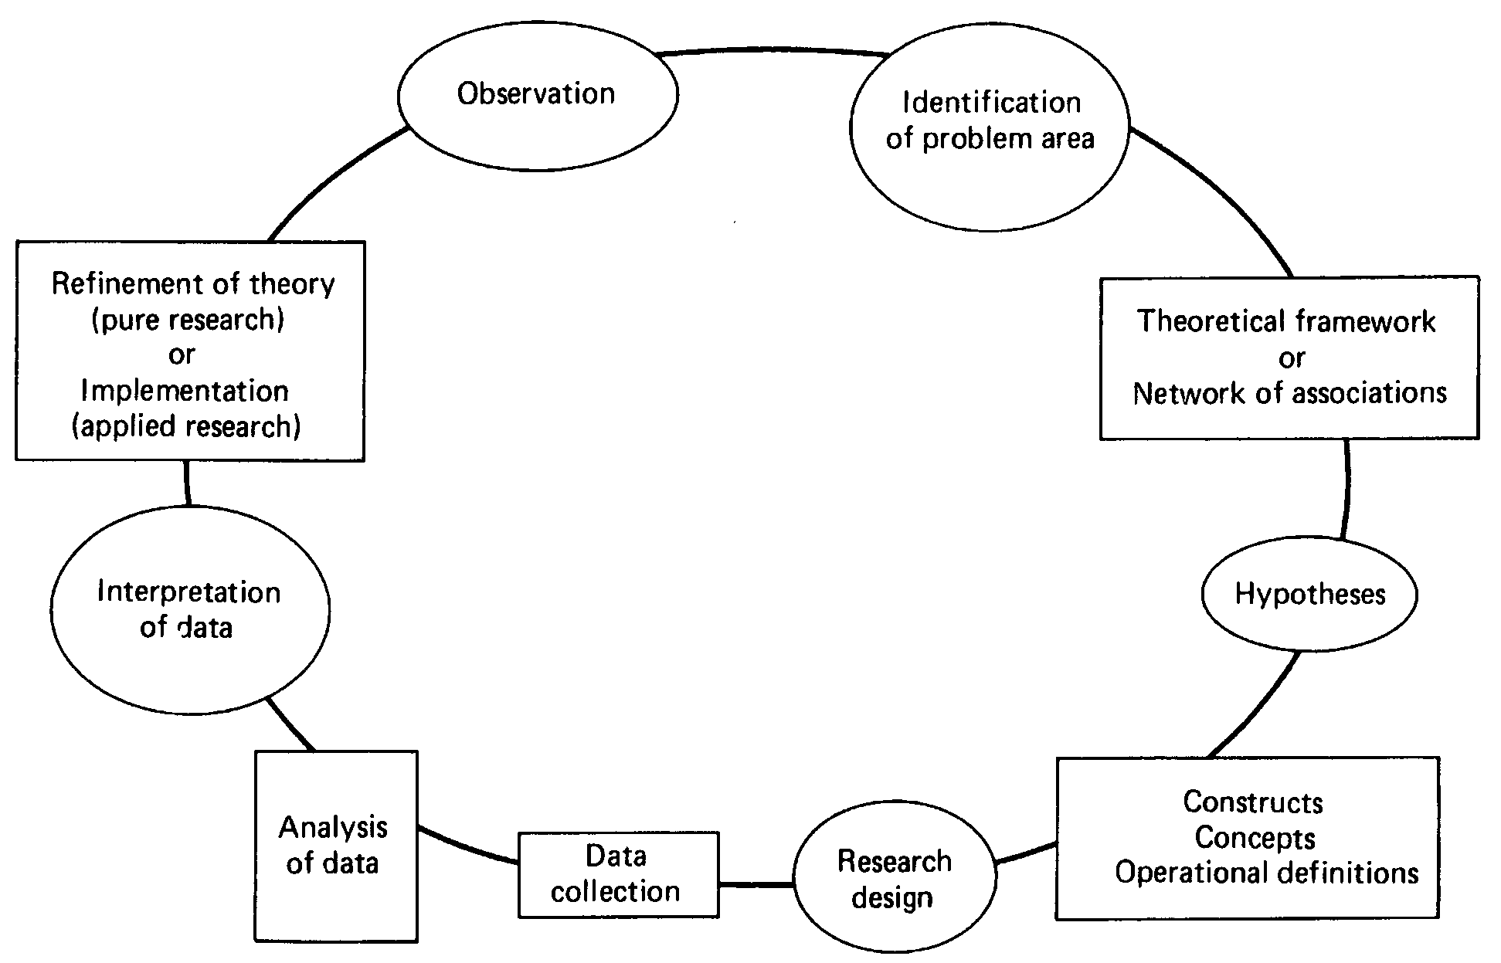
2. The hypothetico-Deductive Method

Slide 52
The 7-step process
Identify a broad problem area
Define the problem statement
Develop hypotheses
Interpretation of data
Determine measures
Data collection
Data analysis

Slide 53
1. Identify a broad problem area
If the manager notice a drop in sales, incorrect accounting results, low-yielding investment, disinterestedness of employees in their work, and the like, could attract the attention of the manager to do a research project.

Slide 54
2. Define the problem statement
Scientific research starts with a definite aim or purpose.
A problem statement states the general objective of the research.

Slide 55
3. Develop hypotheses
The network of associations between the problem and the variables that affect it is identified.
A scientific hypothesis must meet two requirements:
The hypothesis must be testable
The hypothesis must be falsifiable (we can only prove our hypotheses until they are disproved).

Slide 56
4. Determine measures
The variables in the theoretical framework should be measurable in some way.
Some variables can not be measure quantitatively, such as unresponsive employees, we need to operationalize this variable.
Measurement of variables is discussed in Chs. 6 and 7.

Slide 57
5. Data collection
Data with respect to each variable in the hypothesis need to be obtained. There are two types of data:
Qualitative data refer to information gathered through interviews and observations (for objects than can not be physically measured, like feelings and attitudes)
Quantitative data refer to information gathered about objects that can be physically measured. (company records, government statistics, or any formal records)

Slide 58
6. Data Analysis
In this step, the data gathered are statistically analyzed to see if the hypotheses that were generated have been supported.
Analyses of both quantitative and qualitative data can be done to determine if certain relations are important.

Slide 59
7. Interpretation of data
Now we must decide whether our hypotheses are supported or not by interpreting the meaning of the results or the data analysis.
Based on these results, the researcher would make recommendations in order to solve the problem in hand.

Slide 60
Example
Information technology(IT) and Service quality (SQ)
Web 2.0 technologies
(Factors)
Social network
Service quality
(Factors)
Intangible product
Tangible product
Tourism
(sample)
Cosmetic
Company’s site
FB, Twiter…

Slide 61
Quality of website interactivity
Example
H1
H7
H10
Process e-service quality
Quality of inter customer support
H2
H8
H3
Quality of electronic CPV
H6
H11
H9
Output quality directed to service
H4
E-service quality outputs
Output quality directed to customer
H5

Slide 62
Findings after testing hypotheses
Hypotheses
H1~ H6: supported
H7, H8: unsupported (suppose all supported)
H9~H11: supported
Explanations for not supported hypotheses
Data – bias or not
Sample – suitable or not
Situational reasons – other factors
Suggestions

Slide 63
Topics Discussed
The Hallmarks of Scientific research
Some obstacles to conducting scientific
research in the management area
The Hypothetico-Deductive Method
Other types of Research

Slide 64
Other Types of Research
Case studies, and
Action research
Are sometimes used to study certain types of issues.

Slide 65
1. Case Studies
Case studies involve in-depth analyses of similar situations in other organizations, where the nature and definition of the problem is the same as experienced in the current situation.
If a particular hypothesis has not been supported even in a single other case study, the researcher could ignore that hypothesis.
EX:
Tripass – Web 2.0 based community

Slide 66
1. Case Studies
Case studies are not often undertaken in organizations because:
It is very seldom to find similar problems happened in an organizations of the same size and same type of setting.
Many companies prefer to guard their problems and their data.

Slide 67
2. Action Research
Action research is sometimes undertaken by consultants who want to initiate change processes in organizations.
Action research methodology is most appropriate while effecting planned changes.
EX:
Arwin – different channels of delivery information
(ongoing plan)

Slide 68
2. Action Research
The researcher begins with a problem that is already identified, and gathers relevant data to provide a tentative problem solution.
This solution is then implemented, with the knowledge that there may be unintended consequences following such implementation.
The effects are then evaluated, defined, and diagnosed, and the research continues on an ongoing basis until the problem is fully resolved.

Slide 69
Thank You !

